Slide 1
Practical Messaging
A 101 guide to messaging
Ian Cooper
X, BlueSky and Hachyderm: ICooper

Slide 2
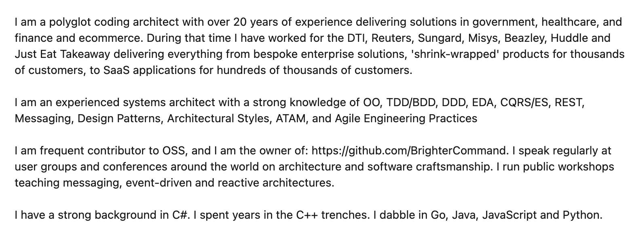
Who are you?
www.linkedin.com/in/ian-cooper-2b059b

Slide 3

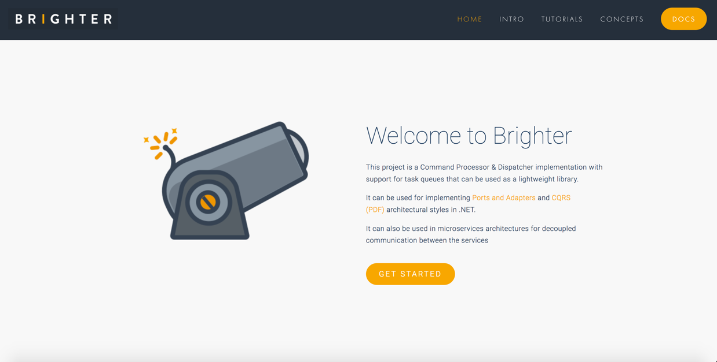

Slide 4
Day One Messaging
Distribution
Integration Styles
Messaging Patterns
Queues and Streams
Managing Asynchronous Architectures

Slide 5
Day Two Conversations
Flow
Process Automation
Conversations

Slide 6
Prerequisites
We will use Rabbit MQ and Kafka for examples. You should have Docker (or an equivalent) installed on your machine, as exercises provide a Docker Compose file to spin up RMQ and Kafka.
You will need to be able to write code with an editor/IDE of your choice.
You can choose from: C#; Java; Python; Go; JavaScript

Slide 7
Course Content
https://github.com/iancooper/practical-messaging

Slide 8
Exercise Code
https://github.com/iancooper/Practical-Messaging-Sharp
https://github.com/iancooper/Practical-Messaging-Python
https://github.com/iancooper/Practical-Messaging-JavaScript
https://github.com/iancooper/Practical-Messaging-Go
https://github.com/iancooper/Practical-Messaging-Java

Slide 9
Day One

Slide 10
Distributed Systems
What is driving messaging

Slide 11
Why Distribute?

Slide 12
Performance and Scalability
Availability
Maintainability
Inherent Distribution
Notes:
Distributed Systems 5m
Once upon a time computer systems were stand-alone, they ran on one-machine. But modern design tends to be distributed with parts running on different computing nodes. Why?
Performance and scalability: As systems become successful it becomes necessary to scale them to meet demand with adequate performance. With a distributed system we can scale-out by introducing new nodes and spread load, and we can also scale up parts of our offering to improve performance by making more expensive hardware available.
Availability: The problem of 'one' plagues computing. If I have 'one' computing node then failure stops my system running. But if we have redundant computing nodes we can rely on those nodes to provide service - perhaps degraded, until we can replace the node. This makes systems fault tolerant.
Maintainability: It becomes hard to maintain large monolithic systems: if you have to test the whole system in order to release it testing becomes an obstacle to release, often slowing release schedules and creating inventory waste; developers find it hard to grasp the 'whole', it's too big to reason about effectively. This often creates a 'banyan tree' anti-pattern with multiple solutions to the same problem, duplication, and if coupling is bad a 'big ball of mud'. Splitting a system into parts creates components that can be developed, QA'd and released independently reducing the problem of complexity to a more manageable size, improving our ability to reason about software, shortening the time to QA software and reducing inventory waste.
Inherent distribution: Some applications are inherently distributed such as business systems that span company divisions in multiple regions of the world, peer-to-peer content sharing etc.

Slide 13
Example: Task Queues

Slide 14
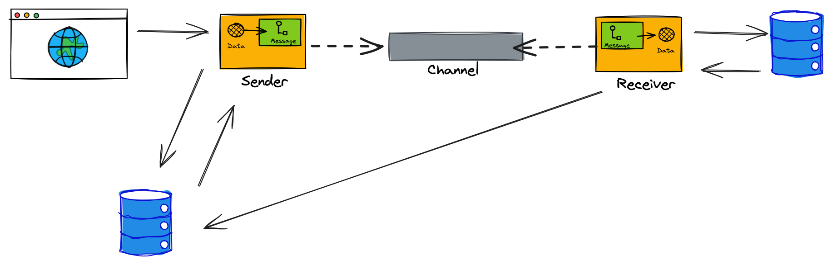
A backend application can perform long-running or CPU intensive work, allowing the web server to service new requests.
The web server puts the work on a queue
The queue stores work until we are ready to consume it. We can throttle to prevent surges.
We can scale out the backend services using a competing consumers approach, to ensure the queue does not backup.

Slide 15
Task Queue
We return 202 Accepted – we have your work request, and won’t lost it.
We enqueue a work item for the request.
Backend app does work at sustainable pace, and updates KV store if required.
We return a Location header, so you can monitor progress.
Link to a progress page, backed by a KV store where we note progress
Link to Resource – 404 until created
Notes:
Task Queue

Slide 16
Example: Microservices

Slide 17
It’s all about velocity!!!
“Speed wins in the marketplace”
Adrian Cockcroft, former lead architect at Netflix
Notes:
Adrian points out that Continuous Delivery is now “table stakes” for digital companies. You can no longer beat the competition if you have a slow release schedule. We want to ship features as soon as they are done, done! Anything else is inventory waste.
To achieve that, we are going to have to build microservices, once we get beyond a single “two-pizza” team
Although microservices offer a range of benefits, the focus of this deck is how alignment with business capabilities gives us greater productivity, which is the justification for expenditure on the effort required to partition a system into microservices.

Slide 18
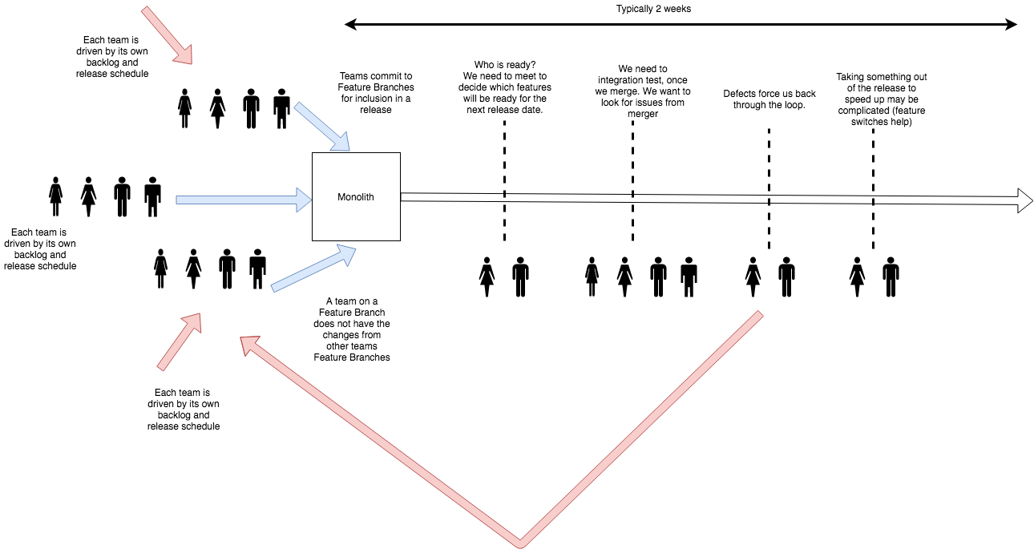
Monoliths Do Not Scale To Many Teams!
Notes:
Monoliths suffer when an organization grows to many teams. Each team has its own backlog, and to avoid contention with other teams changes will branch the repository. When they wish to release, they need to agree with other teams that they will release on a given date, and merge their branch in. Frequently this collides with other teams release schedules, and rather than queue behind each other, they go together. This is because the teams in the rear will have to merge any upstream changes and regression test, before they can release, so to avoid this cost they tend to jump onto the release.
Once all the teams that will join the release are lined up, they merge into the master branch. We then resolve all the conflicts.
More features means more bugs, means greater cost and schedule overruns. If we assume a 30% rework cost, then 30% of 10 days development is 3 days overrun, of 2 days is ½ day.
We must then re-test everything because we have merged potentially incompatible changes.
All the teams now wait on any fixes, even if they belong to another team.
We may be able to drop their changes safely, due to a feature switch, but this can be difficult where they have database changes (a monolith has a shared schema).
Eventually, everyone is ready and we can release, but typically this process takes a couple of weeks. It distracts teams from day-to-day work.
Rollback is also complicated, because we force everyone out. Feature switches and ‘no rollback only roll forward’ become frequent issues.

Slide 19
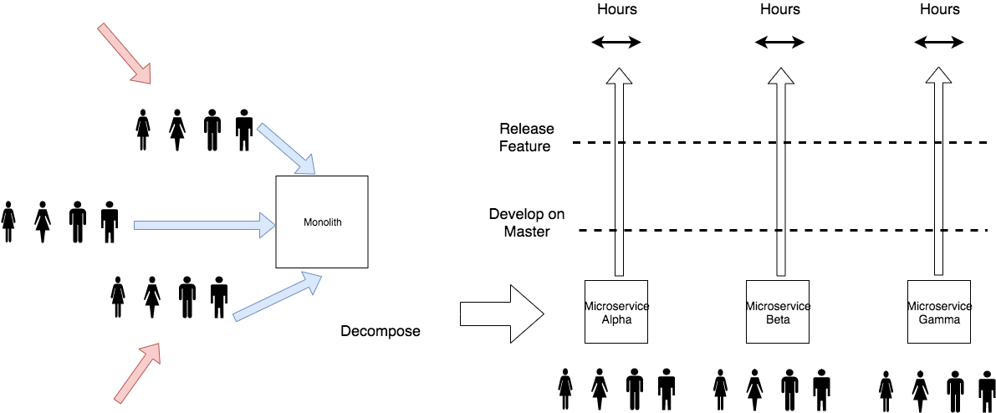
Microservices let us scale an organisation
Notes:
By decomposing software into microservices, oriented around smaller, team-sized units, we can remove these difficulties. Each team only has to negotiate internally to decide on a release candidate.
Typically a team should develop on master behind a feature switch for each story so that they reduce the incidence of any integration costs, and can go straight to production.
Delivery time can be in hours, not weeks.

Slide 20
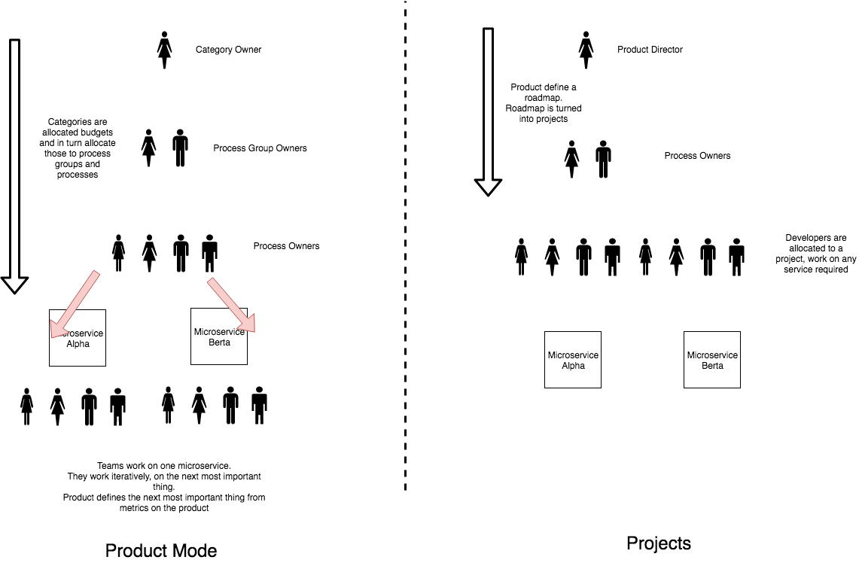
Product Mode
Notes:
In Product mode we allocate resources to products, with a backlog of work for that product, and deliver in an incremental and iterative fashion. There is no end date. Prioritisation is by next highest item. Success is defined by improvement of a metric aligned to a business outcome.
For microservices this means allocating resources to a process, with a backlog of work for that process, which we can deliver on in an incremental and iterative fashion.
In project mode we organise around an item of work that has an end date. Teams work across multiple services to deliver the requirements of the project. Projects are more waterfall than agile as they have significant up-front requirements, and tend to have a long-tail of QA when all the parts must be integrated. Success is defined by ‘keeping to the plan.’ As such projects often conflict with agile methods.
In project mode we have project managers, in product mode we have product owners.

Slide 21
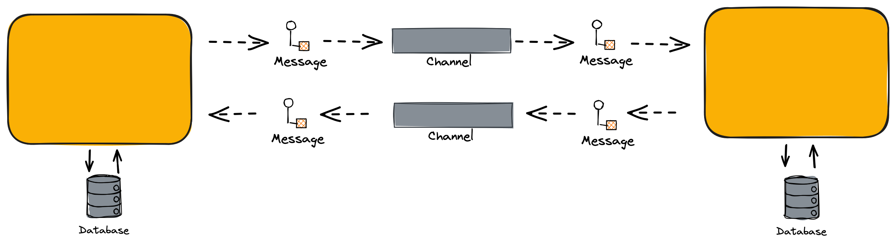
Microservice
The only way to complete tasks within a service is by sending a message. Each service has its own accepted message types and specific data requirements for partners submitting work.
Encapsulated within the service is private data.
Requests to the service do not describe the shape of internal data

Slide 22
Microservice
Transactions cannot occur between different services. If you operate independently from your business partners, you won’t exchange transactions with them. Cross-organizational transactions are avoided to prevent potential lockup of YOUR database if the OTHER organization makes a mistake. Without transactions, you need to communicate through multiple messages over time.
Transactions, including 2PC, may occur within microservices

Slide 23
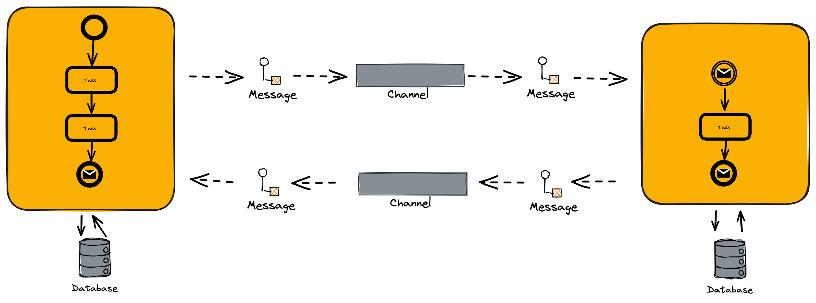
Collaboration
As services are independent of each other, a collaboration comprises orchestrations (handlers, sagas, or workflows) within the services
A collaboration is also the flow of messages, the choreography, between our services

Slide 24
The Price of Distribution

Slide 25
Fallacies of Distributed Computing
The network is reliable.
Latency is zero.
Bandwidth is infinite.
The network is secure.
Topology doesn't change.
There is one administrator.
Transport cost is zero.
The network is homogeneous.
Notes:
Networks are Unreliable
The effects of the fallacies
Software applications are written with little error-handling on networking errors. During a network outage, such applications may stall or infinitely wait for an answer packet, permanently consuming memory or other resources. When the failed network becomes available, those applications may also fail to retry any stalled operations or require a (manual) restart.
Ignorance of network latency, and of the packet loss it can cause, induces application- and transport-layer developers to allow unbounded traffic, greatly increasing dropped packets and wasting bandwidth.
Ignorance of bandwidth limits on the part of traffic senders can result in bottlenecks over frequency-multiplexed media.
Complacency regarding network security results in being blindsided by malicious users and programs that continually adapt to security measures.^{[2]}
Changes in network topology can have effects on both bandwidth and latency issues, and therefore similar problems.
Multiple administrators, as with subnets for rival companies, may institute conflicting policies of which senders of network traffic must be aware in order to complete their desired paths.
The "hidden" costs of building and maintaining a network or subnet are non-negligible and must consequently be noted in budgets to avoid vast shortfalls.
If a system assumes a homogeneous network, then it can lead to the same problems that result from the first three fallacies.
History
The list of fallacies generally came about at Sun Microsystems. L. Peter Deutsch, one of the original Sun "Fellows", is credited^{[by whom?]} with penning the first seven fallacies in 1994; however, Bill Joy and Tom Lyon had already identified the first four as "The Fallacies of Networked Computing"^{[3]} (the article claims "Dave Lyon", but this is a mistake^{[why?]}). Around 1997, James Gosling, another Sun Fellow and the inventor of Java, added the eighth fallacy.^{[3]}

Slide 26
Coupling
What architectural risks do we face from interoperability?

Slide 27
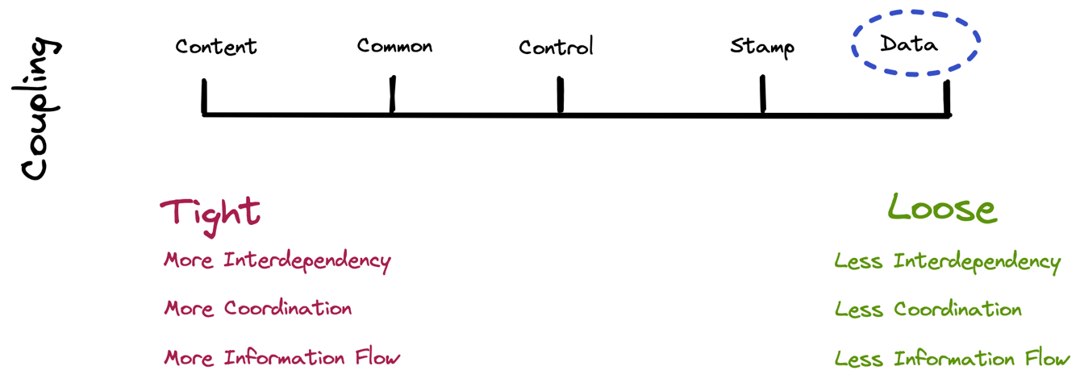
Notes:
Types of coupling
Conceptual model of coupling
Coupling can be "low" (also "loose" and "weak") or "high" (also "tight" and "strong"). Some types of coupling, in order of highest to lowest coupling, are as follows:
Procedural programming
A module here refers to a subroutine of any kind, i.e. a set of one or more statements having a name and preferably its own set of variable names.
Content coupling (high) Content coupling is said to occur when one module uses the code of another module, for instance a branch. This violates information hiding – a basic software design concept.
Common coupling: Common coupling is said to occur when several modules have access to the same global data. But it can lead to uncontrolled error propagation and unforeseen side-effects when changes are made.
Control coupling: Control coupling is one module controlling the flow of another, by passing it information on what to do (e.g., passing a what-to-do flag).
Stamp coupling: (data-structured coupling) Stamp coupling occurs when modules share a composite data structure and use only parts of it, possibly different parts (e.g., passing a whole record to a function that needs only one field of it). In this situation, a modification in a field that a module does not need may lead to changing the way the module reads the record.
Data coupling: Data coupling occurs when modules share data through, for example, parameters. Each datum is an elementary piece, and these are the only data shared (e.g., passing an integer to a function that computes a square root).
Object-oriented programming
Subclass coupling Describes the relationship between a child and its parent. The child is connected to its parent, but the parent is not connected to the child.
Temporal coupling
It is when two actions are bundled together into one module just because they happen to occur at the same time. In recent work various other coupling concepts have been investigated and used as indicators for different modularization principles used in practice.^{[5]}
Dynamic coupling
The goal of this type of coupling is to provide a run-time evaluation of a software system. It has been argued that static coupling metrics lose precision when dealing with an intensive use of dynamic binding or inheritance.^{[6]} In the attempt to solve this issue, dynamic coupling measures have been taken into account.
Semantic coupling
This kind of coupling considers the conceptual similarities between software entities using, for example, comments and identifiers and relying on techniques such as latent semantic indexing (LSI).
Logical coupling
Logical coupling (or evolutionary coupling or change coupling) exploits the release history of a software system to find change patterns among modules or classes: e.g., entities that are likely to be changed together or sequences of changes (a change in a class A is always followed by a change in a class B).

Slide 28
Temporal Coupling
Synchronous Conversation
In a synchronous conversation, both parties must be present for communication to succeed.
Example: a phone call
Request
Reply
Many options: OpenAPI, GraphQL, gRPC, Thrift, SOAP etc

Slide 29

Temporal Coupling
Asynchronous Conversation
In an asynchronous conversation, the receiver does not need to be present at the time the sender communicates with them, using store and forward to pick up the message later.
Example: snail mail
Request
Response
Many options: SQS, Kafka, AMQP 0-9-1 (RMQ), AMQP 1-0, MQTT, S3

Slide 30
Temporal Coupling
If both parties must be present to succeed, we say they are temporally coupled. The availability of one has an impact on the availability of another.
Request
Reply

Slide 31
Integration styles
How do we communicate between microservices?

Slide 32
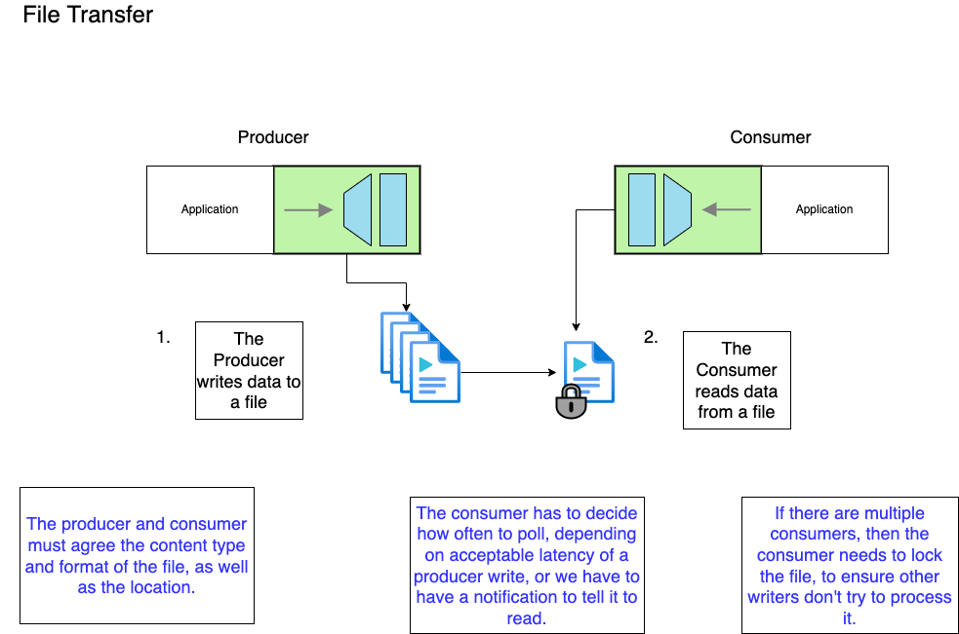
Asynchronous Conversation
Data Coupling

Slide 33
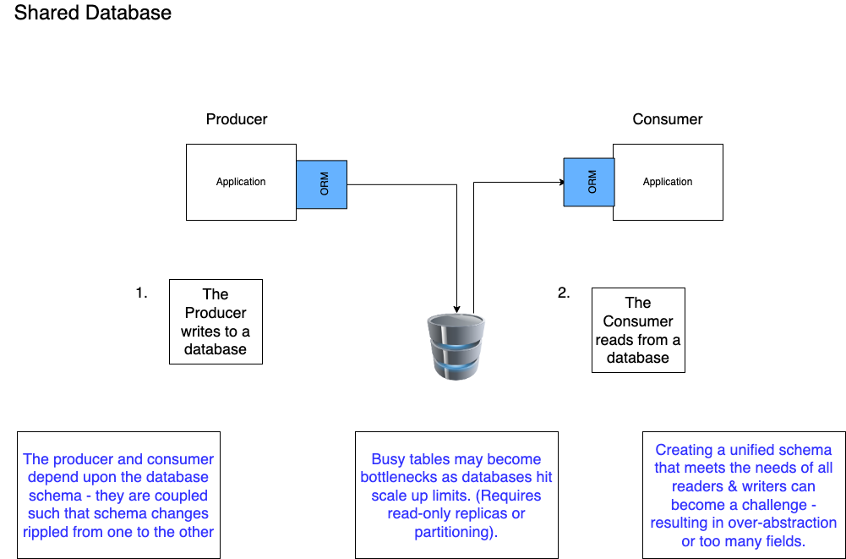
Asynchronous Conversation
Common Coupling

Slide 34
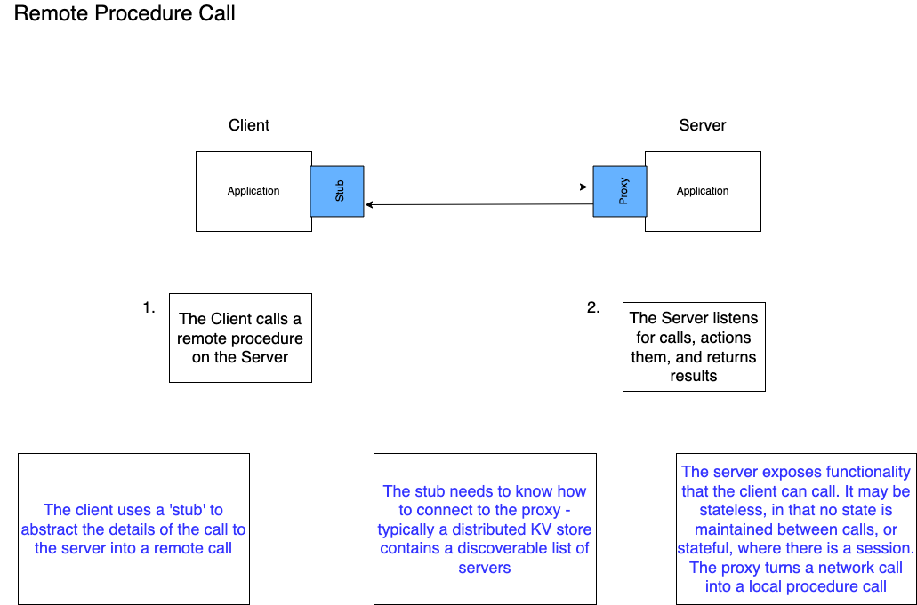
Synchronous Conversation
Control Coupling
Temporal Coupling

Slide 35
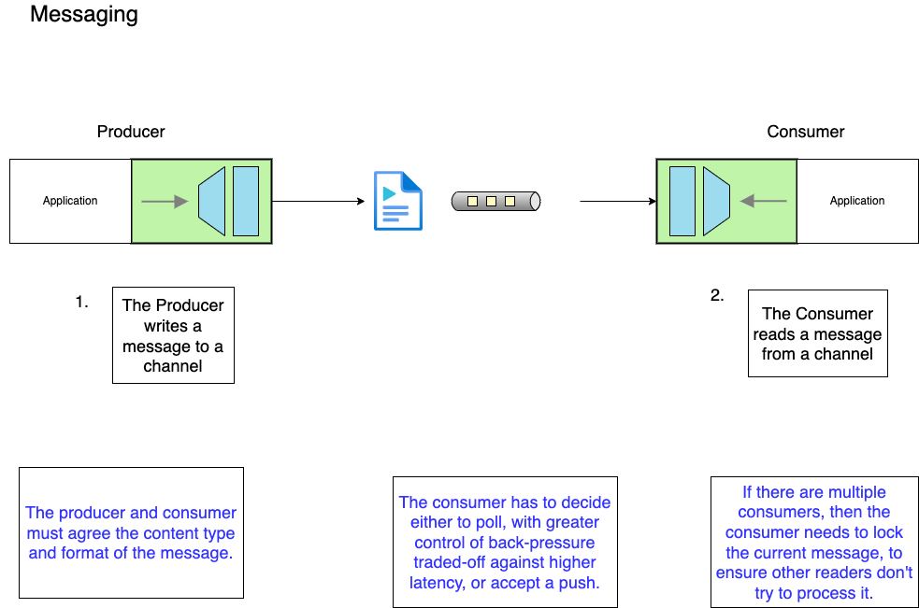
Asynchronous Conversation
Data Coupling

Slide 36
Messaging patterns
Integrating using events

Slide 37
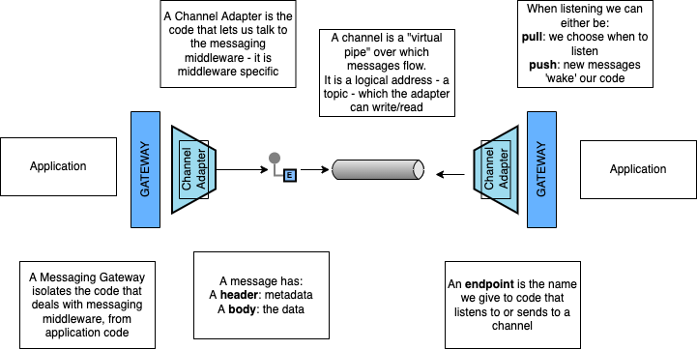

Slide 38
A Message
What is a message?

Slide 39
Message Construction
A message has a header and body
The body contains data for the consumer
The header contains metadata for any filter in the pipeline.
The header should indicate the format of the body
Break a large message into pieces as a Message Sequence or use a Claim Check
Notes:
Two processes communicating need to copy the data between processes - usually as a stream of bytes. We need to break up this stream into discrete units so that we can tell when a message on the channel begins and ends. Otherwise we could not use competing consumers to read messages from the stream or publish to multiple subscribers
A message has a header, how to process and a body, the content
Request-Reply: (Usually Command-Document), tends to use Return Address and Correlation Identifier
In essence RPC over messaging
Break a large message into pieces with Message Sequence
Slow messages: One way to deal with eventual consistency is to create a Message Expiry, and if a message is not delivered within a time-window delete or add to Dead Letter Queue
Message: An atomic packet of data transmitted on a channel
Messaging transmits discrete units of data by marshalling the data from the sender and unmarshalling it in the receiver so that the receiver has its own local copy.
Data to be sent must be converted into one of more messages that can be sent
A message has two basic parts: header (metadata used by the messaging system); body (the payload used by the receiver).
Command Message: Invoke a procedure in another application
Document Message: Pass data to another application
Event Message: Notify another application about a change
Request-Reply: The sender expects a reply
Message Sequence: Split a message into parts; receive before Message Expiration
Canonical Data Format: The body format to be understood by producer and consumer
Message Sequence: Whenever a large set of data needs to be broken into message-size chunks, send the data as a Message Sequence and mark each
The three Message Sequence identification fields are as follows.
Sequence identifier— Distinguishes this cluster of messages from others.
Position identifier— Uniquely identifies and sequentially orders each message in a sequence.
Size or End indicator— Specifies the number of messages in the cluster or marks the last message in the cluster (whose position identifier then specifies
Format Indicator: How can a message’s data format be designed to allow for possible future changes? Design a data format that includes a Format Indicator so that the message specifies what format it is using.
Version Number— A number or string that uniquely identifies the format. Both the sender and receiver must agree on which format is designated by a particular indicator. The advantage of this approach is that the sender and receiver do not have to agree on a shared repository for format descriptors, but the drawback is that each must know what descriptor is indicated and where to access it.
Foreign Key— A unique ID— such as a filename, a database row key, a home primary key, or an Internet URL— that specifies a format document. The sender and receiver must agree on the mapping of keys to documents and the format of the schema document. The advantage of this approach is that the foreign key is very compact and can point to a detailed data format description in a shared repository. The main drawback lies in the fact that each messaging participant has to retrieve the format document from a potentially remote resource.
Format Document— A schema that describes the data format. The schema document does not have to be retrieved via a foreign key or inferred from a version number; it is embedded in the message. The sender and the receiver must agree on the format of the schema. The advantage of this alternative is that messages are self-contained. However, message traffic increases because each message carries format information that rarely changes.

Slide 40
Messaging and Events

Slide 41
Message Types
Messaging
Eventing
Has Intent
Provides Facts
Request An Answer (Query)
Transfer of Control
(Command)
Transfer of Value
Things you Report On
No Expectations
History
Part of a Workflow
Part of a Conversation
Context
Concerned with the Future
Concerned with the Past
After Clemens Vasters https://youtu.be/ITrlLErsqzY

Slide 42
Eventing Types
Series
Discrete
PUSH
PULL
Context
Offset
Stateless
Handler
Stateful
Partition
Processor
Discrete
Continuous
Independent
Sequential
Immediately Actionable
Report Condition
Part of a Conversation
Part of a Monolog
After Clemens Vasters: https://skillsmatter.com/skillscasts/10191-keynote-events-data-points-jobs-and-commands-the-rise-of-messaging
See also: https://en.wikipedia.org/wiki/Discrete_time_and_continuous_time

Slide 43
Message Types
Messaging
Eventing
Command
Event (Notification)
Document
See Gregor Hohpe: https://www.enterpriseintegrationpatterns.com/patterns/messaging/Message.html

Slide 44
Command Message
Use a Command Message to reliably invoke a procedure in another application
Uses the well-established pattern for encapsulating a request as an object. The Command pattern [GoF] turns a request into an object that can be stored and passed around.
Document Message
Use a Document Message to reliably transfer a data structure between applications.
The receiver decides what, if anything, to do with the data
Event Message
Use an Event Message for reliable, asynchronous event notification between applications.
The difference between an Event Message and a Document Message is a matter of timing and content. An event’s contents are typically less important.
Notes:
Command Message: Use a Command Message to reliably invoke a procedure in another application. The advantage o f Remote Procedure Invocation is that it’s synchronous, so the call is performed immediately while the caller’s thread blocks. But that’s also a disadvantage. If the call cannot be executed immediately— either because the network is down or because the remote process isn’t running and listening— then the call doesn’t work. If the call were asynchronous, it could keep trying until the procedure in the remote application is successfully invoked. There’s a well-established pattern for encapsulating a request as an object. The Command pattern [GoF] shows how to turn a request into an object that can be stored and passed around. If this object were a message, then it could be stored in and passed around through a Message Channel (60). Likewise, the command’s state (such as method parameters) can be stored in the message’s state. Usually sent over a Point-to-Point channel as there is only one consumer.

Slide 45
Exercises
Self-paced material

Slide 46

Exercise material
Introduction to Exercises
Readme
Videos
Scripts & Slides
Introduction to RMQ

Slide 47
channels

Slide 48
Channels
A virtual pipe that connects producer and consumer
Logical Address (Topic or Routing Key)
Unidirectional
One-to-One or One-to-Many
Messaging is a ‘pipe’ not a ‘bucket’.
Notes:
# Channels #
A producer and a consumer communicate via a channel. A producer sends to a particular channel and a consumer reads from a particular channel
When we talk about messaging patterns, a channel is a logical view of the system not a physical one.
It is the virtual pipe down which messages flow.
Because the pipe is virtual, it's presence is just a logical address to which messages can be sent, and from which they can be received: this may be called a topic or a routing key, depending on the middleware.
Different Message Oriented Middleware solutions may provide different physical implementations of channels, such as whether messages are stored on in memory, on sender and receiver, or in a distributed database.
These details are hidden from producer and consumer who only need to know how to address a channel
A channel is one-way -- we don't want to consume our own messages. For bi-directional messaging we use two channels, one for the request, and one for the reply (the reply channel is usually communicated by the sender)
Messaging is one-to-one (Point-to-point Channel) or one to many (Publish-Subscribe Channel)
A messaging system is not implemented as a bucket. A receiver knows what type of information it wants, and the sender can identify what it is.

Slide 49
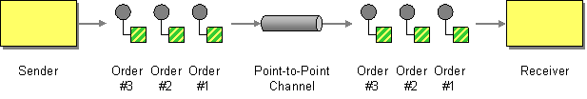
Point-to-Point Channel
http://www.enterpriseintegrationpatterns.com/patterns/messaging/PointToPointChannel.html
Notes:
# Point-to-Point Channel #
With a Point-to-Point Channel only one consumer receives any message. If the channel has multiple consumers, the channel ensures that only one of them succeeds, so the receivers do not have to coordinate with each other.
The channel typically locks a message, either until the locking consumer acks or nacks it, or until the consumer times out on responding and the message is made available again.
If the message is acked, it is deleted from the queue.
Whilst the message is locked, other consumers read past the locked message.
Thus the application can scale out by having multiple consumers receive messages concurrently, but only a single consumer receives any one message.
If the channel chooses to return messages to the channel following a timeout, consumers may have to be prepared to receive duplicate messages, or abandon processing messages, before they time out.

Slide 50
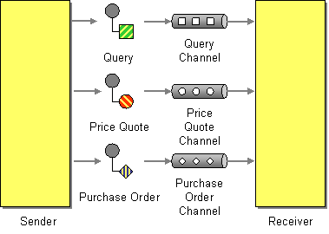
Datatype Channel
http://www.enterpriseintegrationpatterns.com/patterns/messaging/DatatypeChannel.html
Notes:
# Datatype Channel #
When a producer sends a message, how does the consumer know how to process it?
How does it know what the schema of the message body is, in order to deserialize the content and act upon it?
We can use a separate channel for each separate message schema, so that all messages on a particular channel share the same schema.
The producer, knowing what type the message is, publishes to an appropriate channel serializing the data to the message body.
The consumer, knowing what channel the message was received on, will know what its type is, and can deserialize the message body.
If a Datatype channel is not used, then the consumer will need to inspect the message to determine the type, using metadata in the message header or body, and then lookup how de-serialize messages of that type, before routing them to code that knows how to handle them.
This is unneeded complexity if a separate channel can be used.
The reason not to use a datatype channel is where there are messages that need to be processed in sequence but the messages have different schemas and they cannot be unified under a single schema.

Slide 51
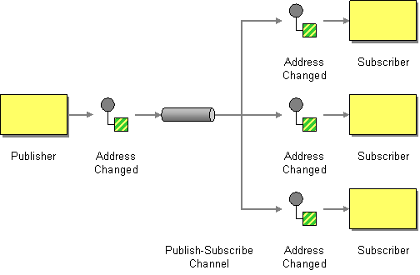
Publish-Subscribe Channel
http://www.enterpriseintegrationpatterns.com/patterns/messaging/PublishSubscribeChannel.html
Notes:
# Publish-Subscribe Channel #
If in a point-to-point channel only one consumer receives a message, how do I broadcast a message so that many consumers receive the same message?
Publish the message on a Publish-Subscribe Channel, which delivers a copy of a particular message to each consumer.
A Publish-Subscribe Channel has a publisher who sends a message to one input channel which is then replicated onto many output channels, each belonging to a separate subscriber.
When an event is published into the channel, the Publish-Subscribe Channel delivers a copy of the message to each of the output channels.
Each output channel functions much as a point-to-point channel. On any output channel, a consumer is only allowed to receive a message once. The middleware must use locking and read past to ensure that with multiple listeners, only one listener consumes the message.
Publish-subscribe allows eavesdropping on a message; a firehose of all channels can act like a message store.
A message may be sent by one publisher and consumed separately by many consumers via a router, which we discuss later. Both the channel and router based approach are often short-handed as publish-subscribe.

Slide 52
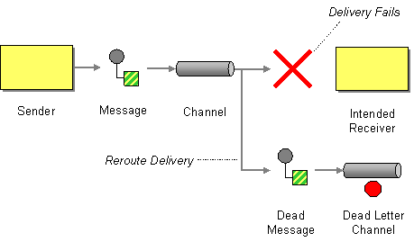
Dead Letter Channel
http://www.enterpriseintegrationpatterns.com/patterns/messaging/DeadLetterChannel.html
Notes:
# Dead Letter Channel #
What does the middleware do with a message a publisher sends, that it cannot deliver to the intended channel?
It may choose to move the message onto a Dead Letter Channel, which can later be reviewed by the operator. Often, the middleware will attempt redelivery of the message to channel a number of times, before it moves it to a dead letter channel.
Implementations vary. For example, a dead letter channel might be a point-to-point channel that can be read by one consumer, or a publish-subscribe channel that can be read by many consumers.
There is confusion between a dead letter channel, and an invalid message channel (the next pattern we will look at). We will discuss that issue further when considering that pattern.

Slide 53
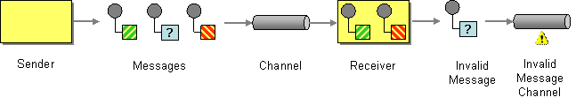
Invalid Message Channel
http://www.enterpriseintegrationpatterns.com/patterns/messaging/InvalidMessageChannel.html
Notes:
# Invalid Message Channel #
What happens when the message a consumer receives cannot be understood? For example the message is missing headers, or the body has an unexpected content type or does not match the expected schema.
Although the middleware has delivered the message to the receiver it cannot be passed to application code to process.
Further attempts to process the message will continue to result in failure because it is badly formed. The message risks becoming a 'poison pill' as the consumer will continue to try to read it from the channel. If there is a single consumer it will be blocked from reading other messages. If there is more than one consumer, a consumer will continue to 'choke' on that message.
But simply removing the message from the channel, by acking it but discarding it, risks that we will lose data. For example, it might be that a badly configured producer or consumer was using the wrong channel and the message was good.
The consumer should move the message to an Invalid Message Channel, a special channel for messages that could not be processed by their receivers.
Messages that cause application errors, but are well formed, should not be placed on the Invalid Message Channel, but treated as application errors.
The Dead Letter Channel is for messages that cannot be delivered to the channel, and the Invalid Message Channel is for messages that were delivered, but cannot be understood.
Some middleware, for example RabbitMQ confuses these terms, and uses Dead Letter Channel as an Invalid Message Channel, the destination for messages that the consumer rejects.

Slide 54
endpoints

Slide 55
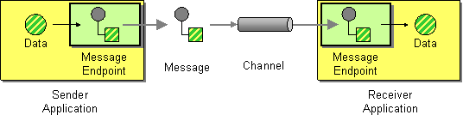
Message Endpoint
http://www.enterpriseintegrationpatterns.com/patterns/messaging/MessageEndpoint.html
Notes:
# Message Endpoint #
How does an application connect to a messaging channel to send and receive messages?
Our preference would be to separate the concerns of messaging, from the concerns of the domain. A developer should not need to understand the details of working with middleware, message formats, messaging channels, or any of the other details of communicating with other applications via messaging.
Application code just knows that it has data to send to another application, or is expecting data from another application.
It is the messaging endpoint code that takes that data, makes it into a message, and sends it on a particular messaging channel. It is the endpoint that receives a message, extracts the contents, and gives them to the application in a meaningful way.
A Message Endpoint abstracts the details of communication with messaging channels when sending or receiving messages. Message Endpoint code is custom to middleware's client API.

Slide 56
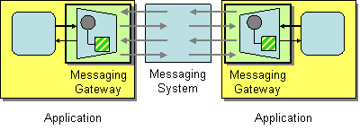
Messaging Gateway
http://www.enterpriseintegrationpatterns.com/patterns/messaging/MessagingGateway.html
Notes:
# Messaging Gateway #
Within our Message Endpoint, we encapsulate the code that accesses the middleware in a Messaging Gateway. In this way, we isolate all the dependencies on the middleware into one component -- the Gateway.
Our domain code is isolated from messaging concerns.
What is the difference between a Gateway and an Endpoint? The Endpoint contains the Gateway, but may also contain code to run a message pump, to map messages to domain types, call application code in the domain. In this model, the Gateway only abstracts the interaction with middleware, it does not provide the other features of a Message Endpoint.
We might create an endpoint that supports multiple middleware offerings. The gateway abstracts their individual implementation details, so that the endpoint code, which interacts with application code, can switch between different types of middleware, without the application code needing to change.

Slide 57
The Message PuMP

Slide 58
Dead Letter Channel
Error Log
Error Log
Invalid Message Channel
Failure to understand
Unexpected
Unrecoverable
Exception
Failure to deliver
Get Message
Translate Message
Dispatch Message
Handle Message
Requeue to Limit
Recoverable
Exception
Notes:
# The Message Pump #
The Message Pump is the name given to the code that takes a message from a channel and delivers it to application code. The pump runs in a loop, until cancelled.
The loop takes messages from the channel, and then translates the data in the message body into a type that can be understood by the application code.
The pump then looks up application code registered to handle messages of that type, and sends the translated message to that application code to be handled.
Control passes from the Message Endpoint to application code, which executes in response to receipt of the message and handles it.
When errors occur in the middleware, whilst attempting to deliver the message to the endpoint, the message can be moved to a Dead-Letter Channel.
When errors occur translating a message, then the message can be moved to an Invalid Message Channel.
If errors occur dispatching a message to application code, it should be logged, and an exception thrown, as the application has been incorrectly configured. The message should not be acked and the application should be shut down, to avoid losing data.
If errors occur in the application code, and those errors are not recoverable, then the message should be acked to remove it from the channel, as replaying it would have the same consequences, and the error should be logged. Processing may be able to continue with subsequent messages.
If the message could be retried, because the condition causing the error is transient, then the message can be put back onto channel (usually with a delay) to retry. An upper limit on the number of retries is usually placed, to avoid poison pill messages. Ideally, messages that exceed the retry limit, should be handled the same way as an unrecoverable exception

Slide 59
Translate and Dispatch
Message Mapper Registry
Handler Registry
Lookup Mapper
Lookup Handler
Get Message
Translate Message
Dispatch Message
Handle Message
Notes:
A Messaging Mapper converts domain objects into a message as required by the messaging channel.
It also provides the reverse capability, create or update a domain objects based on an incoming messages.
Because of this mediator, the domain does not need to know about messaging formats and vice-versa
Typically, the endpoint allows registration of message mappers for channels, and uses a data type channel.
The application code that executes in response to a message it typically called a handler. Typically, handlers are subscribed to channels that the endpoint is configured to listen on.

Slide 60
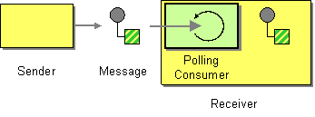
Polling Consumer
http://www.enterpriseintegrationpatterns.com/patterns/messaging/PollingConsumer.html
Notes:
# Polling Consumer #
In a Polling Consumer, the message pump makes an explicit call to check for the availability of messages to consume. This consumes a thread in the application, even if no messages are ready, but does not require a connection to be held open to the middleware.

Slide 61

Event Driven Consumer
http://www.enterpriseintegrationpatterns.com/patterns/messaging/EventDrivenConsumer.html
Notes:
# Event Driven Consumer #
In an Event Driven consumer, the message pump registers a callback with the middleware, and it is called when a message is available to be read, and passed the message. This does not consume a thread in the application, but it does require the connection between the client and the middleware server to be held open or for the application to serve requests from the middleware.

Slide 62
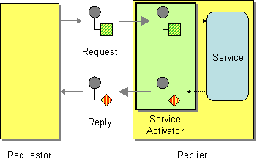
Service Activator
http://www.enterpriseintegrationpatterns.com/patterns/messaging/MessagingAdapter.html
Notes:
# The Service Activator #
Whilst the message pump outlined directs calls to application code in response to messages, it is valuable for that code to be invoked by other callers. This is particularly useful to support writing developer tests against the handler, but can also allow the same code to service requests received via different protocols for example HTTP or GRPC.
A Service Activator is the pattern by which the endpoint code invokes application code to handle the message, but that application code is independent of the messaging endpoint. This can be synchronous and non-remote a method call - usually exposed by a service layer. The activator can be hard-coded to always invoke the same service, or can use reflection to invoke the service indicated by the message. The activator handles all of the messaging details and invokes the service like any other client, such that the service doesn’t know it’s being invoked through messaging.
A Service Activator can be one-way (request only) or two-way (Request-Reply).

Slide 63
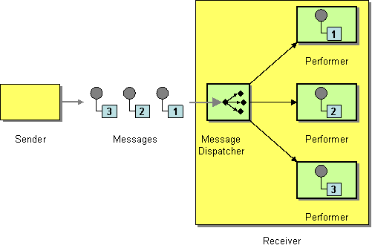
Competing Consumers
http://www.enterpriseintegrationpatterns.com/patterns/messaging/MessageDispatcher.html
Notes:
# Competing Consumers #
If we wish to avoid a channel backing up, we must consume messages from the channel faster than they arrive. A simple algorithm helps with this. We compare the rate of arrival of messages with the rate of consumption of messages - how long before we ack or nack that message. If the rate of arrival exceeds the rate of consumption, we will back up. If this is not a burst of messages, and if we do not have a rate of consumption greater than that of arrival, we will not be able to eat our way through any backlog; we will now never catch up.
We may also need to process the message within a certain period from when they are published. If those messages come in bursts, but the processing of individual messages in the burst takes too long, we might not be able to process within that period.
The solution to both of these issues is to increase the number of consumers reading messages from the channel. The message queue must hand a message to only one consumer, so it must lock the message on the channel whilst it is being processed, and unlock it if it is returned to the channel. For example if the consumer fails. It must allow waiting consumers to read messages further down the channel if the message at the front is locked.
Competing consumers can create a problem with messages that need to be processed in sequence. Due to the requirement to lock and read past, consumers will not be able to guarantee that they will process messages on a channel in sequence. Indeed they may undo any sequence that the channel has already. In this case you cannot use competing consumers.
Instead, if the rate of arrival exceeds the rate of consumption you must partition the messages using a consistent hashing algorithm such that you can preserve order within a partition and ensure that the rate of arrival of messages on a partition does not exceed the rate of consumption of messages from a single consumer of that partition.

Slide 64
Pipelines

Slide 65

Pipes and Filters
http://www.enterpriseintegrationpatterns.com/patterns/messaging/PipesAndFilters.html
Notes:
# Pipes and Filters #
When we publish a message, we may need to do work before the eventual subscriber of that message takes action against our domain. We might need to encrypt/decrypt a message, we might need to enrich the content of the message from other data stores, or we might need to transform the message from one format to another.
Pipes and filters is a pattern for dividing the transformation of data between origin and destination into steps that can be combined together. A data source at the head of the pipe begins the flow, and a data sink at the tail of the pipe receives the transformed output. Filters transform the data as it flows through the pipe.
We can treat the publisher as the data source, the final consumer as the data sink. and consumers that read, transformed, and publish that message before it reaches the sink as filters.
The structure of pipes and filters is straightforward. Each filter receives a message on an inbound channel and publishes it on an outbound channel. The pipe connects one filter to the next, sending output messages from one filter to the next. Because each filter uses the same approach they can be composed into a chain. This allows simple, easily testable filters to be composed into arbitrarily complex applications.
A processing pipeline lets us work in parallel, because a filter can take more work off the queue to process when done, instead of blocking whilst the rest of the pipeline completes. This is known as a processing pipeline because messages flow through the filters like liquid through a pipe. A processing pipeline helps to increase throughput. A processing pipeline's throughput is limited by the slowest point in the chain. We could use multi-threading within that filter, but the alternative is to use competing consumers to parallelize the work of a stage. This allows one of many consumers to complete the work of that stage and is simpler to program and debug than using multi-threading.

Slide 66
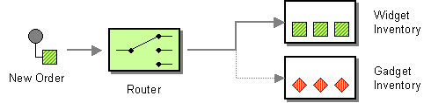
Content Based Router
http://www.enterpriseintegrationpatterns.com/patterns/messaging/ContentBasedRouter.html
Notes:
# Content Based Router #
We may need a pipeline to branch. The condition that determines which path to take, may be based on the content of the message.
A Content-Based Router examines the message content and routes the message onto a different channel based on data contained in the message. The routing can be based on a number of criteria, such as existence of fields, specific field values, and so on.
The routing function should be easy to maintain, as the router can become a point of frequent maintenance. Some middleware provide configurable rules-engines to support complex routing decisions or topologies. Be wary of moving too much decision making into middleware as this can become difficult to maintain or test.

Slide 67
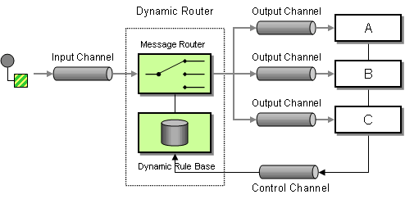
Dynamic Router
http://www.enterpriseintegrationpatterns.com/patterns/messaging/DynamicRouter.html
Notes:
# Dynamic Router #
A content-based router can be difficult to maintain, because the router has to know about the possible branches in the path, thus creating a need to re-configure that router if the topology of the system changes.
A dynamic routers solves this problem by using a rules-engine to send messages to destinations which can be configured at run time.
A control channel allows configuration of the routing to be set by consumers. As a consumer starts up, it registers with the router to indicate the rules under which it should be sent messages. The Dynamic Router runs the rules over a message on receipt and determines the destination.
Because consumers supply the rules under which the message should be routed to them, the dynamic router must determine what happens if two rules conflict, indicating that a message should be forwarded to more than one channel. Common strategies include last one wins. It is possible to route to all valid routes, but this is often actually another pattern: the recipient list.

Slide 68
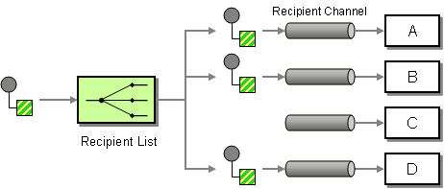
Recipient List
http://www.enterpriseintegrationpatterns.com/patterns/messaging/RecipientList.html
Notes:
# Recipient List #
In a content-based router, the properties of the message determine which branch a message takes. We may want the publisher to be able to explicitly decide which branches to take, by means of a recipient list of which paths should receive the message.
A metaphor here is the To list of an email - we indicate the recipients of the email and it is routed to them.
We define a channel for each recipient. The Recipient List inspects an incoming message, determine the list of desired recipients, and forwards the message to all channels associated with recipients in the list.
It is possible to invert the recipient list to give control to the consumers. In a dynamic recipient list, consumers send a list of messages they wish to subscribe to, via a control channel, to the Recipient List. This allows them to filter the messages that they wish to receive.
A dynamic Recipient List can be used to implement a Publish-Subscribe Channel if a messaging system provides only Point-to-Point Channels but no Publish-Subscribe Channels. The Recipient List would keep a list of all Point-to-Point Channels that are subscribed to a topic. The publisher indicates the topic when sending the message, and the Recipient List routes the message to channels subscribed to that topic. This can be used to provide control, such as authorization, of subscriptions to a topic
Exchanges in RabbitMQ and SNS subscriptions in AWS are examples of dynamic recipient lists.

Slide 69
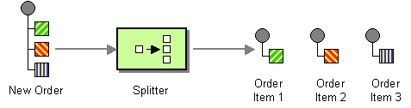
Splitter
http://www.enterpriseintegrationpatterns.com/patterns/messaging/Sequencer.html
Notes:
# Splitter #
It may be that filters in the pipeline correspond to parts of a message, and it may be more efficient to split a message into multiple messages, derived from those dependencies, and send those new messages to those filters.
A splitter takes one input message, and breaks it into multiple output messages.
For example, different line items in an order, may need be handled by different consumers, and a splitter can route each line item in the order to the correct consumer.
It may also be useful where there is a batch of work in the original message. It can be difficult to observe the progress of a batch, it is either all waiting to be done, or done. Splitting the batch up allows us to observe the progress on the parts of the batch more easily, by the simple expedient of monitoring the number of messages waiting to be processed in the channel.

Slide 70
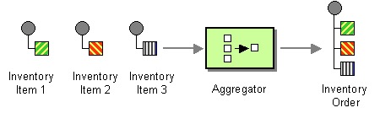
Aggregator
http://www.enterpriseintegrationpatterns.com/patterns/messaging/Aggregator.html
Notes:
# Aggregator #
A Splitter lets us break out a single message into parts, multiple messages that can be processed individually. It may be necessary to recombine these parts for further processing.
For example, when we use a Splitter to break up a batch job, we want to know when the batch completes, because all of the parts of the batch have completed. We also want to know if some parts of a batch completed, but others did not.
An Aggregator collects and stores individual messages until a complete set of related messages has been received. Then, the Aggregator publishes a single message distilled from the individual messages.
An Aggregator depends on being able to correlate messages, usually by adding a correlation id to the message headers, to easily allow messages to be recombined. With a batch, it can also be useful for the aggregator to know how many messages were i the batch, so that the aggregator knows when it has seen all the messages.

Slide 71
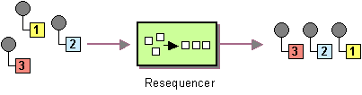
Resequencer
http://www.enterpriseintegrationpatterns.com/patterns/messaging/Resequencer.html
Notes:
# Resequencer #
If the pipeline has conditional or parallel filter steps, some messages may complete the pipeline before others. If the messages were published in order, that order may now be lost.
In the presence of errors, a filter step might be retried, which may move the retried message out of order.
If we have competing consumers reading from a channel, they will de-order the messages arriving on that channel.
If we need to re-order messages we can use a Resequencer. A Resequencer uses an internal buffer to store out-of-sequence messages until a complete sequence is obtained. The in-sequence messages are then published to the output channel.
The Resequencer needs to store the sequence number of the next expected message. A Resequencer first looks in its own buffer, to see if it has already read that message from the channel. If not, it reads another message from the channel. If that is the expected message it processes it, otherwise it puts it into the buffer. The process then repeats. Eventually, a message waiting in the buffer will be the next message, and will be freed.

Slide 72
Transformation

Slide 73
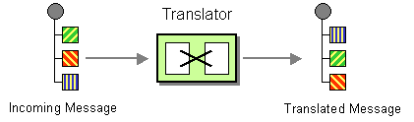
Message Translator
http://www.enterpriseintegrationpatterns.com/patterns/messaging/MessageTranslator.html
Notes:
# Message Translator #
The publisher may not use a format for a message that is understood by all consumers. This may be a version issue -- a downstream consumer may not be ready to receive a message whose format has a breaking change. It may be an issue with schemas that are not under control of the engineering team, such as external system or legacy code.
A message translator is a filter step that converts a message from one schema to another, so that the output can be received by consumers that accept the alternative format.
In many cases a translator is temporary, once the consumer can accept the schema of the publisher then the translator can be retired.

Slide 74
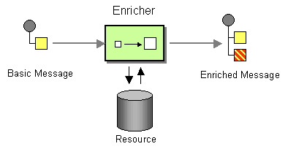
Content Enricher
http://www.enterpriseintegrationpatterns.com/patterns/messaging/DataEnricher.html
Notes:
# Content Enricher #
The data source in a pipeline, the publisher, may not have all the data that the data sink, the consumer, needs to process the message.
Imagine that the publisher sends a new order with an account id, but to ship the order we need the customer's address details, which are held on their account. The shipping consumer needs the customer's address to be added to the order message, before it can process the message.
This scenario is particularly common in microservice architectures, where each microservice only holds data that pertains to its area of responsibility and not others, requiring the data in the publisher's message to be joined to data held by other microservices.
A Content Enricher is a filter step that adds the required data to the message.
In the above example, one system publishes the order, a filter step belonging to another system listens to that message and enriches the content with the address data, and the system that handles shipping now has the data that it needs to process the order.

Slide 75
Queues and Streams

Slide 76
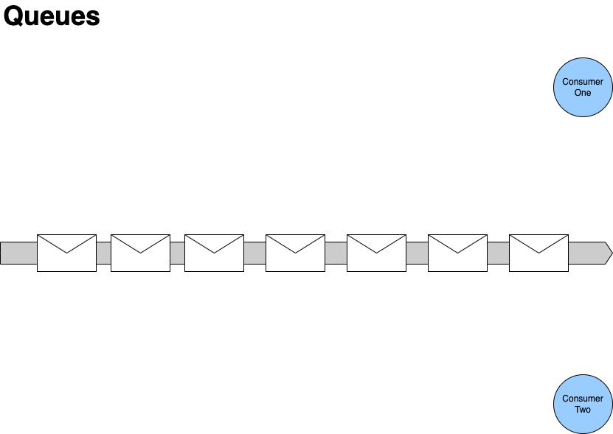

First consumer locks the next message in the queue whilst it processes it.
Second consumer locks the next available message in the queue.
Second consumer reads past any locked message in the queue.

Slide 77
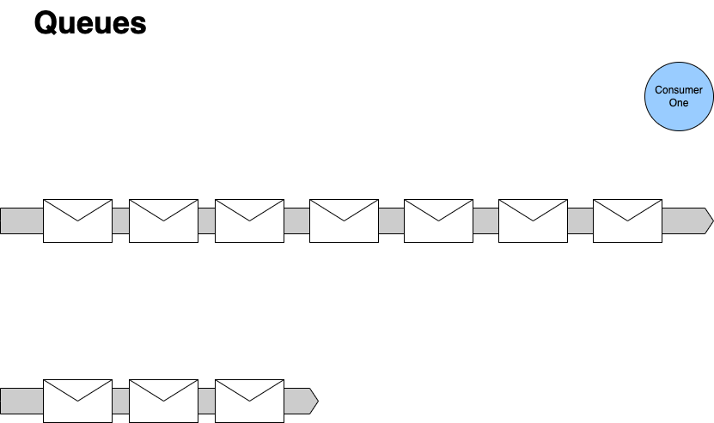



When we are done processing, we unlock it.
- Usually because we finish processing it
- May be because we fail.
If we fail, then we may decide others could succeed later, so we let it become available to lock again, often with a delay.
If we succeed, then we delete the message from the queue, no one else can now process it.
Queues contain Tasks
With queues we can think of the messages on a queue as tasks - they are a request for us to carry out an action. Once the action is done, we can delete the task.
- We don't anyone else to action it, it's already been done.
- Someone receiving a done task will have to discard it.
- If we can't action it, someone else will need to action it.
After a certain number of re-queues we may move the message to a dead-letter channel, it turns out that no one action the request within in a reasonable time frame

Slide 78
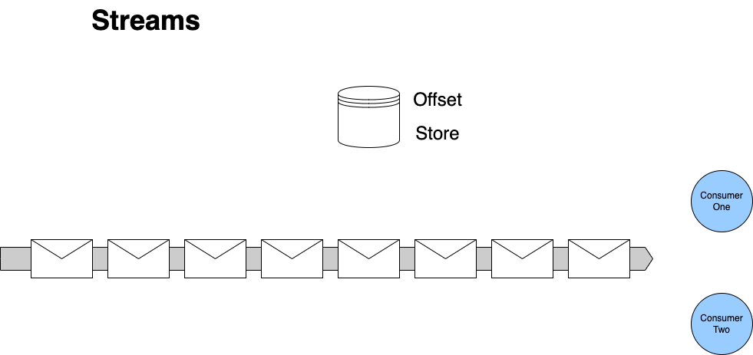
First consumer stores an offset to mark how far it has read
First consumer reads the next message in the queue and processes it.
First consumer reads the next message in the queue and processes it.
If a consumer restarts
It reads the store to determine the last message it processed
Second consumer stores an offset to mark how far it has read
Streams contain Facts
With streams we can think of the records on the stream as facts - they are records that indicate there has been a change in state.
We can view facts as an ‘inverse database’ they represent how current stat is arrived at
We can navigate offsets to calculate a position at a ‘point in time’
We don’t consume facts by reading them, they persist
Second consumer reads the next message in the queue and processes it.

Slide 79
Scaling Queues and Streams

Slide 80
First consumer locks the next message in the queue whilst it processes it.
Second consumer reads past any locked message in the queue.
Second consumer locks the next available message in the queue.
Competing Consumers
We scale consumption of a queue by adding more consumers

Slide 81
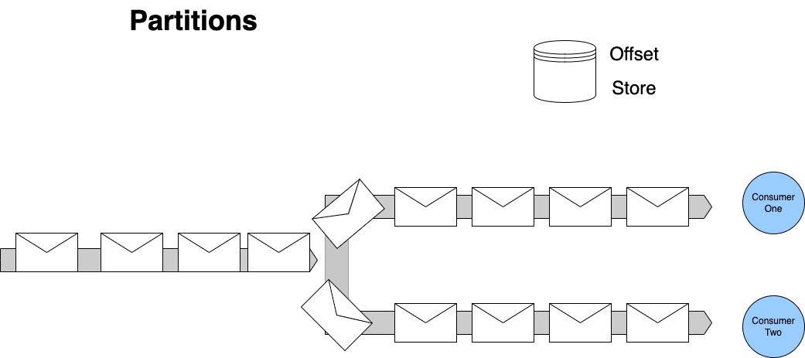
Streams
Each consumer manages offsets for their partition.
To scale out we must divide the stream up. We partition the stream to allow multiple consumers to read it.
For any set of events that must be processed sequentially - all changes to one entity for example - we use consistent hashing to push messages with the same identifier to the same partition. This allows us to scale, whilst preserving our ordering.

Slide 82
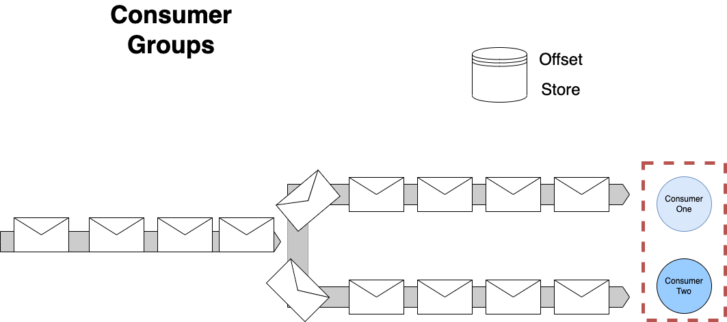
Streams
To provide availability – only one consumer in a group can read from a partition at a time – but a consumer in a group may read from more than one of the partitions owned by that group

Slide 83
Archive and Replay

Slide 84
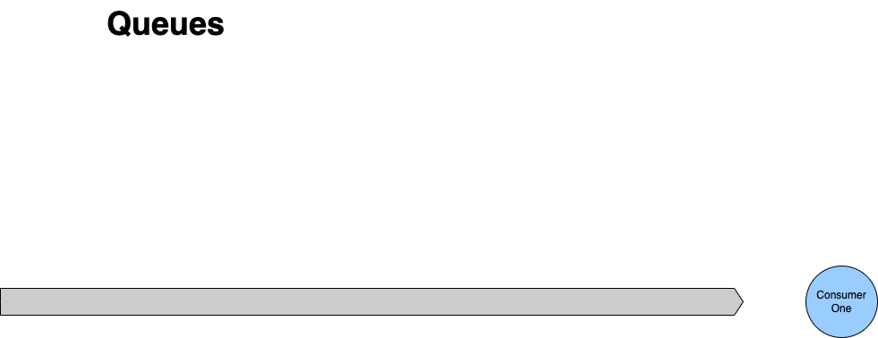

If we succeed, then we delete the message from the queue, no one else can now process it.
No Archive and Replay
With queues we delete a message once we have completed the associated action. That means we have no way to replay the request for work. Our only option is to ask the producer to resend their request.

Slide 85
We don’t delete a message, we just increment the offset.
Archive and Replay
Archive and Replay is straightforward as nothing is deleted. We simply reset the consumer’s offset to re-read the stream

Slide 86
Requeue and Delay (Backpressure)

Slide 87
When we are done processing, we unlock it.
- Usually because we finish processing it
- May be because we fail.
If we fail, then we may decide others could succeed later, so we let it become available to lock again, often with a delay.
If we succeed, then we delete the message from the queue, no one else can now process it.
Requeue and Delay (Backpressure)
A queue supports re-queue (with delay)
If the work is not done/acked, just make it available again to the next consumer
If the work could not be done because of a transient issue, delay to let is pass
After a certain number of re-queues we may move the message to a dead-letter channel, it turns out that no one action the request within in a reasonable time frame

Slide 88
We don’t delete a message, we just increment the offset.
No Requeue or DLQ
Because we do not lock items, we do not requeue items, including requeue with delay. Your strategy is:
Ignore and Continue (Load Shedding)
Retry (Backpressure)
Copy to another stream (a delay or DLQ stream)

Slide 89


 | Messaging | Discrete Event | Series Event
Queue
Stream
 | Ordering | Archive and Replay | Requeue with Delay
Queue
Stream

Slide 90
Exercise material
Introduction to Kafka
Readme
Slides

Slide 91
Transactional Messaging

Slide 92
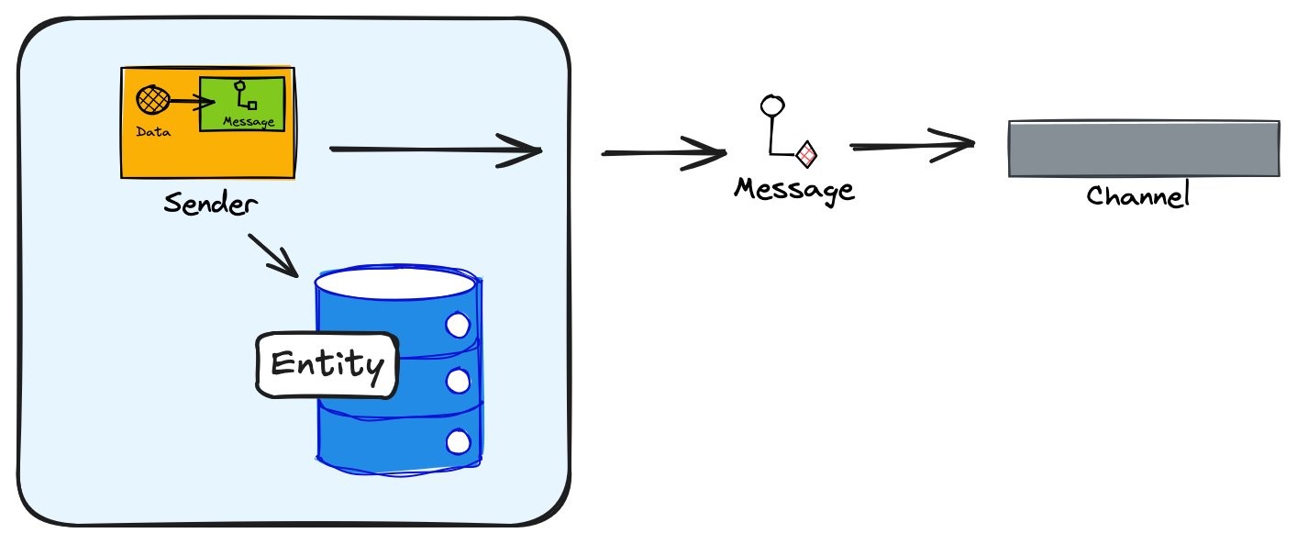
Transactional Messaging
If the message send fails, downstream systems will not be consistent with upstream systems.
If we reverse the operations and the message is sent but the Db write fails, the upstream is inconsistent.
No transaction spans both my write to the Db for an entity, and my sending of a message.
Notes:
Explain mapping and transactional outbox. Use slide-09-outbox-pattern.

Slide 93
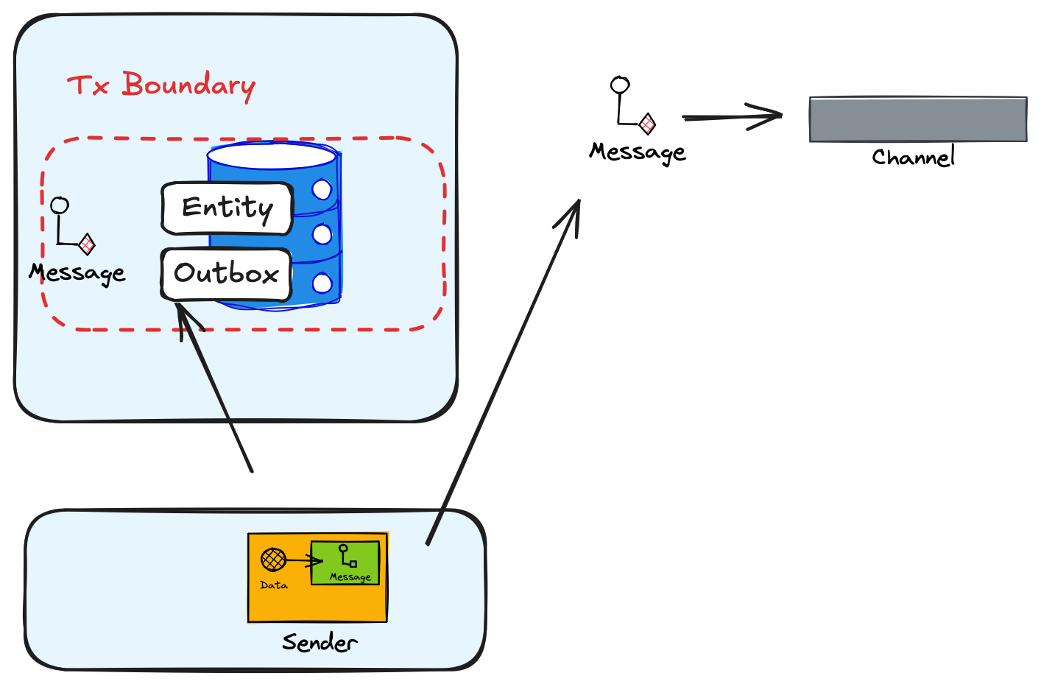
Outbox
Instead of writing directly to the channel, we open a transaction, update our entity, and write the message we want to send to an Outbox table as Pending.
A background “sweeper” process can then run at an interval to flush any Pending items (over an age) from the Outbox table
To reduce latency, we can send from the application, after writing as well, with the sweeper just a backup
Once we have sent, we mark the message as Sent in the Outbox table

Slide 94
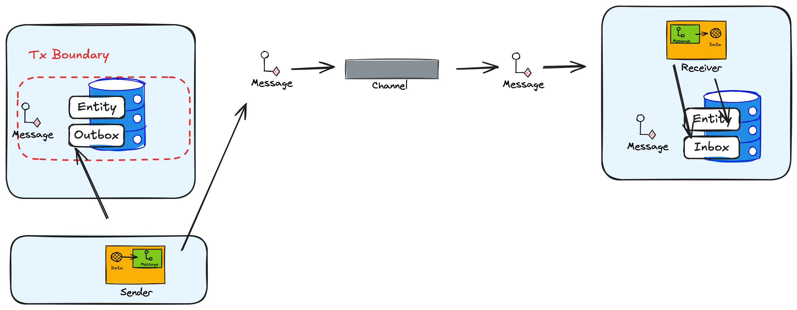
Inbox
If the message is not idempotent (side-effect free), then we use an Inbox to record messages seen (working on) and processed (might fail)
We cannot guarantee that we fail not mark dispatched after a send, so we may send the same message twice

Slide 95
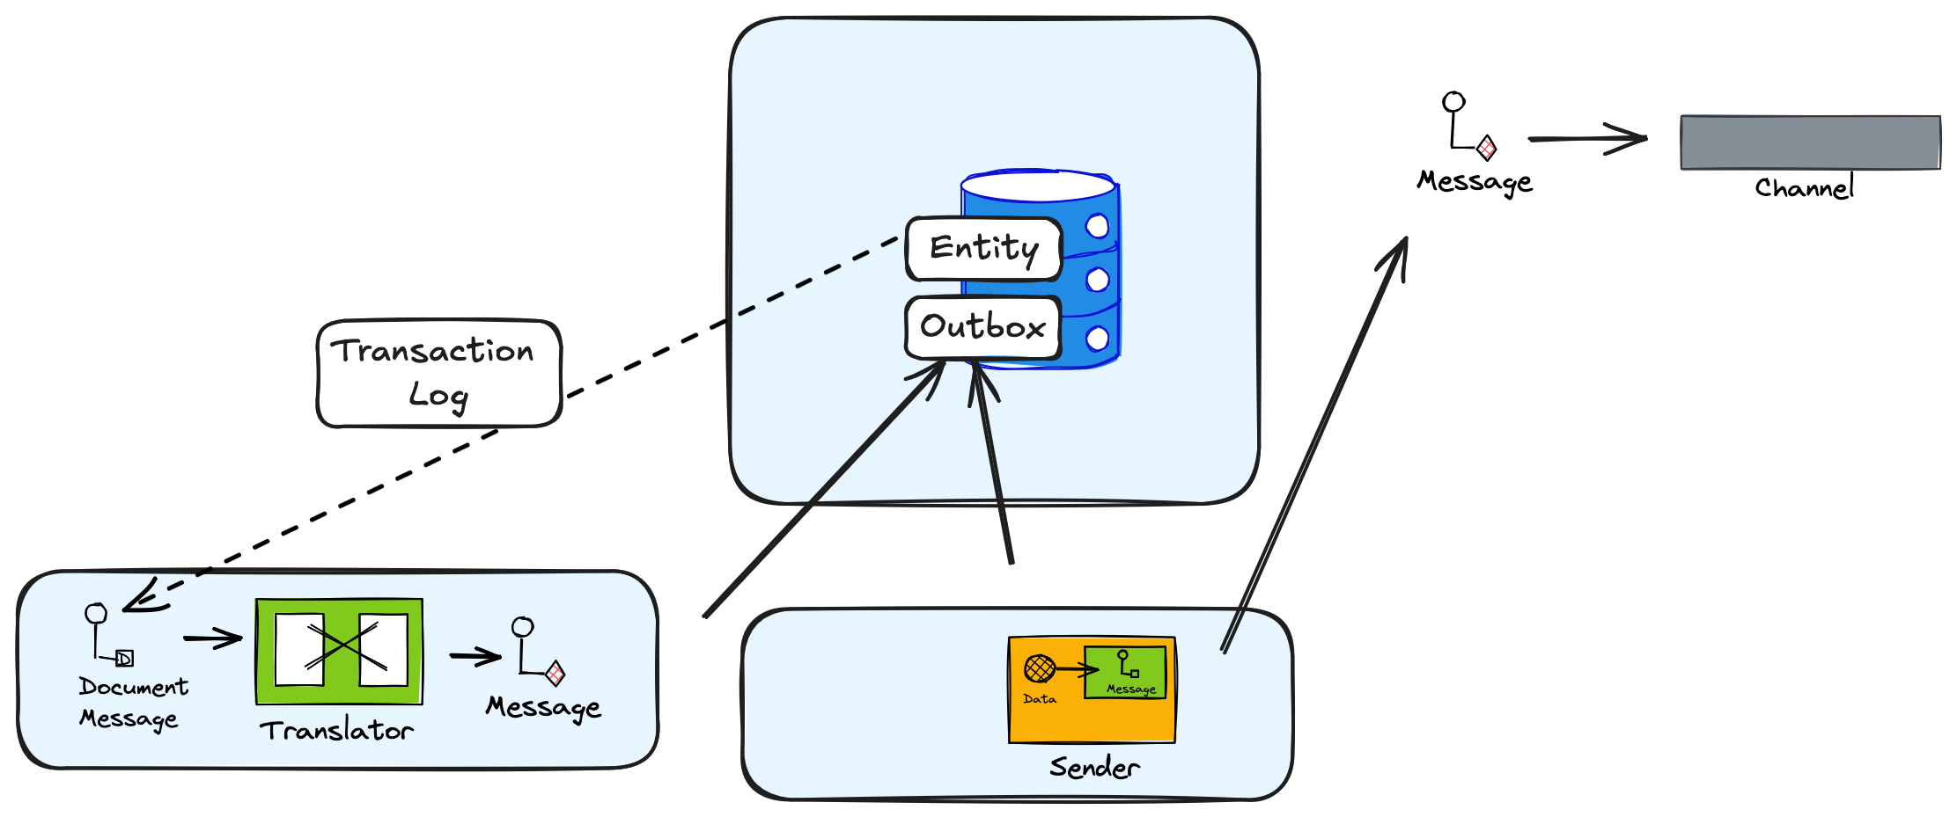
Log Tailing
We may not be using a database that supports ACID transactions, across Outbox and Entity tables
A common mistake is to send the transaction log directly, which couples the Db schema to the outgoing event, and can only block if the broker is down
Again, our sender, sends the outstanding Outbox entries and marks them as sent in the Outbox
In this case we can tail the transaction log, translate the log (via domain code) into a message and store in the Outbox

Slide 96
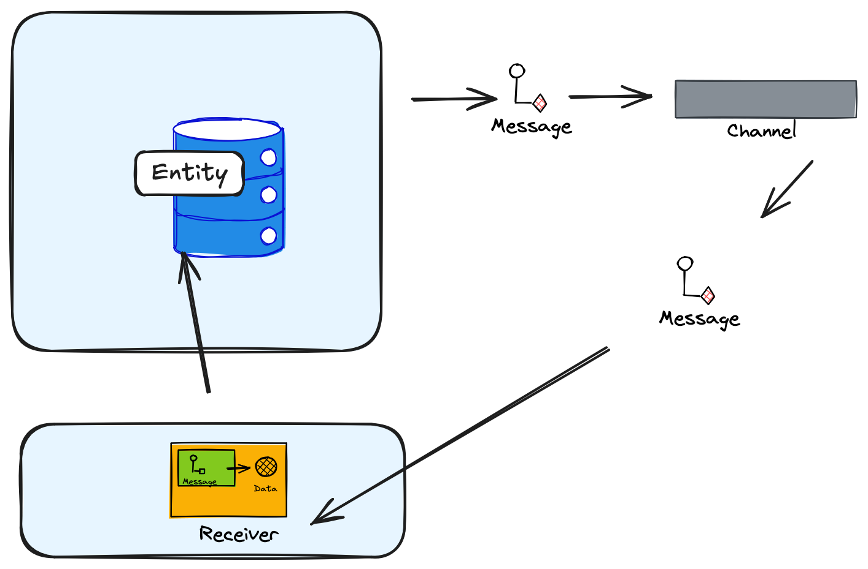
State Change Capture
A low-cost alternative is to send the message before we write to the entity. If the message sends, we have guaranteed delivery.
We read the message from the channel and then update the entity. The main issue is that we must be able to cope with EVENTUAL CONSISTENCY, which is not always simple.

Slide 97
Managing Asynchronous APIs

Slide 98
Versioning

Slide 99
Be strict when sending and tolerant when receiving. Implementations must follow specifications precisely when sending to the network, and tolerate faulty input from the network.
Robustness Principal or Postel’s Law – Jon Postel RFC 1958

Slide 100
Tolerant Reader
{
"$schema": "http://json-schema.org/draft-07/schema#",
"type": "object",
"properties": {
"orderid": {
"type": "string"
},
"customerName": {
"type": "string"
},
"addressLineOne": {
"type": "string"
},
"postCode": {
"type": "string"
},
"pinCode": {
"type": "string",
"pattern": "^[0-9]+$"
}
},
"required": ["orderid", "customerName", "addressLineOne", "postCode", "pinCode"],
"additionalProperties": false
}
{
"$schema": "http://json-schema.org/draft-07/schema#",
"type": "object",
"properties": {
"orderid": {
"type": "string"
},
"customerName": {
"type": "string"
},
"addressLineOne": {
"type": "string"
},
"postCode": {
"type": "string"
},
"pinCode": {
"type": "string",
"pattern": "^[0-9]+$"
},
"latitude": {
"type": "number",
"minimum": -90,
"maximum": 90
},
"longitude": {
"type": "number",
"minimum": -180,
"maximum": 180
}
},
"required": ["orderid", "customerName", "addressLineOne", "postCode", "pinCode"],
"additionalProperties": false
}
Ignore New Fields
Notes:
A general rule when versioning events is that adding things does not cause a versioning conflict. Adding a new version of an event is therefore not a problem, as long as we don’t break the definition of a new version event; it must be convertible from an old version of the same event. Following these rules, when old versions are read from the store, they can first be converted, or upcasted, to the latest version before handled. This means that an event handler only needs to know how to deal with the latest version, an important benefit if many new versions have been created. To be able to convert an old version of an event when a property has been added to the new version, we use the same principle as when we add a new not nullable column to a database; we use a default value.
With Additive Changes we can process new messages on old consumers
New Consumers must default missing values from older messages
Might use Enricher.

Slide 101
Tolerant Reader
{
"$schema": "http://json-schema.org/draft-07/schema#",
"type": "object",
"properties": {
"orderid": {
"type": "string"
},
"customerName": {
"type": "string"
},
"addressLineOne": {
"type": "string"
},
"postCode": {
"type": "string"
},
"pinCode": {
"type": "string",
"pattern": "^[0-9]+$"
},
"latitude": {
"type": "number",
"minimum": -90,
"maximum": 90
},
"longitude": {
"type": "number",
"minimum": -180,
"maximum": 180
}
},
"required": ["orderid", "customerName", "addressLineOne", "postCode", "pinCode"],
"additionalProperties": false
}
Default Latitude: 0
Default Longitude: 0
Note: not required
Default Missing Fields

Slide 102
Breaking Change
{
"$schema": "http://json-schema.org/draft-07/schema#",
"type": "object",
"properties": {
"orderid": {
"type": "string"
},
"firstName": {
"type": "string"
},
"surName": {
"type": "string"
},
"addressLineOne": {
"type": "string"
},
"pinCode": {
"type": "string",
"pattern": "^[0-9]+$"
},
"latitude": {
"type": "number",
"minimum": -90,
"maximum": 90
},
"longitude": {
"type": "number",
"minimum": -180,
"maximum": 180
}
},
"required": ["orderid", "firstName", "surName", "addressLineOne", "pinCode", "latitude", "longitude"],
"additionalProperties": false
}
We might be able to write code to deal with this change, but we have to know that a required field is missing and we have new fields instead
For this we need to rely on a version in the header, and the ability to process messages with this new version, alongside old ones to allow us to run out the old until new replaces it.
Notes:
With Breaking Changes we should create a new message type.
Source systems may need to send original and new, or we have to source the missing information in a Message Translator in the pipeline

Slide 103
Documentation

Slide 104
Endpoints are places where messages are sent or received (or both), and they define all the information required for the message exchange.
An endpoint describes in a standard-based way where messages should be sent, how they should be sent, and what the messages should look like.
https://docs.microsoft.com/en-us/dotnet/framework/wcf/fundamental-concepts

Slide 105


- Do I want to search all the GitHub Repos in case you documented it?
- Do I want to put a message out on Slack or Teams asking if anyone knows who exposes it?
?
Restaurant Availability
How do I know who exposes the data that I need? How do I find the endpoint that I want to consume from?

Slide 106
- Do I search all the GitHub Repos looking for the name of my message hoping to find it?
- Do I want to put a message out on Slack or Teams asking if anyone consumes it?
?
Endpoint
RestaurantHoursChanged
Restaurant Management
Who consumes the messages I send? Whom do I have a contract with?

Slide 107
Asynchronous Endpoints
Our Asynchronous APIs need documenting just like any other API (HTTP etc).
We need to document the message, because it is the contract
Endpoint
Restaurant Availability
Downstream
Restaurant Management
We need to document who sends and receives to understand flow
We need to document the channel so we know where the message is flowing
We need to document the protocol so we know how to send-receive

Slide 108
Endpoint – Documenting the Contract
An endpoint is where messages should be sent, how they should be sent, and what the messages should look like. What promises do we make.
Endpoint
An message is data that we send or receive
We will need to agree what the metadata – the headers are – and we will need to agree the encoding and schema of the body.
Message
Upstream
Metadata (Headers)
Endpoint
Data (Payload)
RestaurantHoursChanged
Channel
Downstream
Restaurant Management
A channel is the logical pipe over which messages flow. It is our address.
Binding
A binding is the details of how we implement the channel: what transport and encoding does the service support that allows messages to flow for example AMQP and Plain/Text.
In principle you can have multiple bindings for a channel.

Slide 109
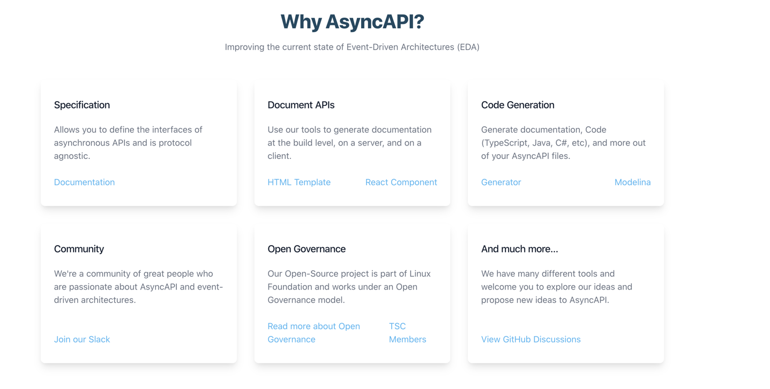

Slide 110
AsyncAPI Elements (V3)
Operations send or receive messages over channels.
Binding
Application
Operations
Channels
Message
Binding
P
H
An application is running code that has operations:
producer (sends messages) - -
consumer (receives messages)
A message must have a payload and can have headers. Headers may protocol or application specific.
Server
Bindings are protocol specific information
Binding
A server has a protocol by which messages are exchanged.

Slide 111
Document Structure (V3)
AsyncAPI Object
The root object. Identifies the application being documented
Info Object
Metadata for this specification
Servers Object
Connection details for the server
The channels being used by the application
Channels Object
Operation Object
Defines an operation – publish or subscribe – made available by the application on this channel
Components Object
Re-usable components
Tags Object
User defined tags for this specification

Slide 112
AsyncAPI (V3) and Endpoint ABCs
AsyncAPI Object
Endpoint
Info Object
Message
Servers Object
Metadata (Headers)
Channels Object
Data (Payload)
Channel
Operation Object
Binding
Components Object
Tags Object

Slide 113
Info Object
info:
contact:
name: Paramore Brighter
url: https://goparamore.io/support
email: support@goparamore.io
license:
name: Apache 2.0
url: https://www.apache.org/licenses/LICENSE-2.0.html
description: Demonstrates sending a greeting over a messaging transport.
title: Brighter Sample App
version: 1.0.0
tags:
- name: brighter examples

Slide 114
Servers Object
development:
description: A Kafka broker for local development
url: localhost:9092
protocol: kafka

Slide 115
Channels (V3)
greeting:
address: ‘goparamore.io.greeting’
summary: For sending greetings
description: This channel contains greeting messages
servers:
- $ref: '#/servers/development’
messages:
greeting:
$ref: "#/components/messages/greeting”
bindings:
kafka:
partitions: 20
replicas: 3

Slide 116
Operations (V3)
sendGreeting :
action: send
summary: sends a greeting
description: The application sends a greeting to a consumer.
channel:
$ref: "#/channels/greeting”
bindings:
kafka:
partitions: 20
replicas: 3

Slide 117
Components
components:
messages:
greeting:
name: greeting
title: A salutation
summary: This is how we send you a salutation
contentType: application/json
traits:
- $ref: '#/components/messageTraits/commonHeaders'
payload:
$ref: "#/components/schemas/greetingContent"
schemas:
greetingContent:
type: object
properties:
greeting:
type: string
description: The salutation you want to send
…

Slide 118
JSON Schema (AsyncAPI Schema Object)
$schema
{
”$schema” : "https://json-schema.org/draft/2020-12/schema",
“$id” : “https://goparamore.io/greeting.schema.json”,
“title” : “greeting”,
“description” : “A greeting message”,
“type” : “object”,
“properties” : {
“greeting” : {
“description” : “the salutation”
“type” : string
}
}
}
$id
title
description
type
properties

Slide 119
Avro
Complex Types:
records
enums
arrays
maps
unions
fixed
Records:
name
namespace
doc
alias
fields
name
doc
type
default

Slide 120
Avro
{
“type” : “record”,
“name” : “greeting,”
“title” : “greeting”,
“fields” : [
{“name” : “greeting”, “type” : “string”}
]
}

Slide 121
Avro
Encodings:
JSON
Languages:
C
Binary
C++
C#
Java
Perl
Python
Ruby
Others…

Slide 122
Protobuf
syntax = "proto3";
message Greeting {
string greeting = 1;
}

Slide 123
Protobuf
Encodings:
Binary
Languages:
C++
C#
Dart
Go
Kotlin
Java
Objective-C
Python
Ruby
Others…

Slide 124
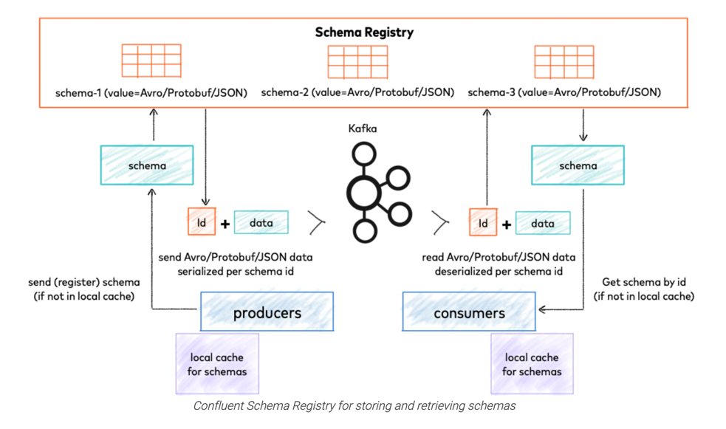
Schema Registry
https://docs.confluent.io/platform/current/schema-registry/index.html

Slide 125
Cloud Events
Id - unique identifier
Unique
source - production context
Required Attributes
specversion - CE version
Event
type - name + version
Metadata
Optional Attributes
Payload
datacontenttype - MIME type
dataschema - URI of payload schema
subject – qualifies source
Data
time – timestamp (Internet)

Slide 126
Protocol Binding
Binding Type
amqp 1-0
avro
Binary
http
Uses the protocol’s native approach to metadata
http-webhooks
CloudEvent
kafka
mqtt
Structured
nats
Adds headers to the payload (envelope)
protobuf
websockets

Slide 127
Protocol Binding
Binary
Structured
------------------ Message -------------------
Topic Name: mytopic
------------------- key ----------------------
Key: mykey
------------------ headers ------------------- ce_specversion: "1.0"
ce_type: "com.example.someevent"
ce_source: "/mycontext/subcontext"
ce_id: "1234-1234-1234"
ce_time: "2018-04-05T03:56:24Z"
content-type: application/avro
------------------- value --------------------
... application data encoded in Avro ...
-----------------------------------------------
------------------ Message -------------------
Topic Name: mytopic
------------------- key ----------------------
Key: mykey
------------------ headers -------------------
content-type: application/cloudevents+json; charset=UTF-8
------------------- value --------------------
{
"specversion" : "1.0",
"type" : "com.example.someevent",
"source" : "/mycontext/subcontext",
"id" : "1234-1234-1234",
"time" : "2018-04-05T03:56:24Z",
"datacontenttype" : "application/json",
"data" : {
... application data encoded in JSON ...
}
}
-----------------------------------------------

Slide 128
AsyncAPI Object
id: https://github.com/brightercommand/greetings/
We use a specification file for an app, which is a producer or consumer, and identify them by id

Slide 129
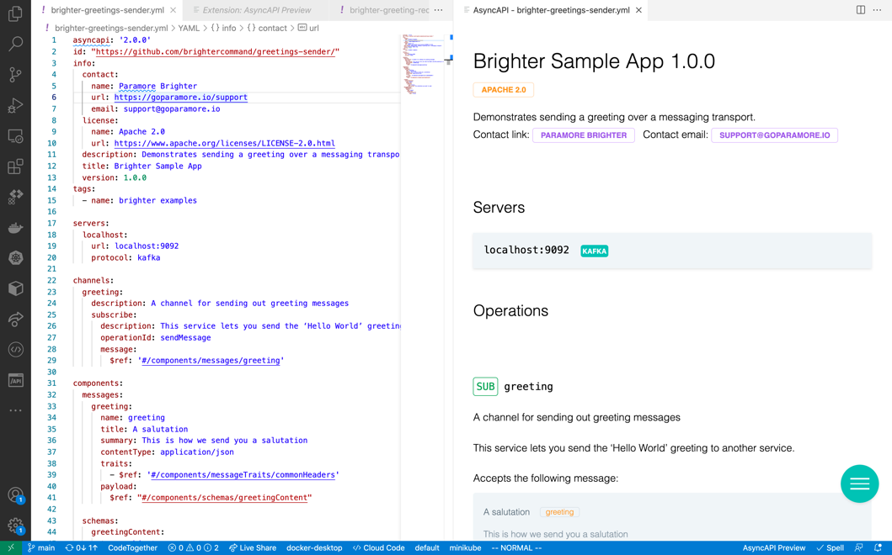
VS Code

Slide 130
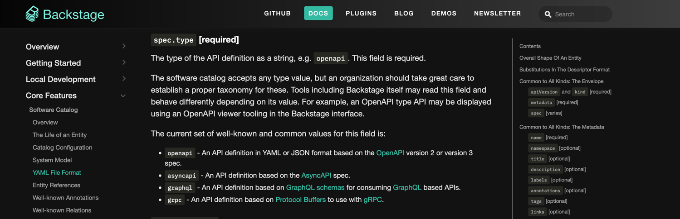
Backstage

Slide 131
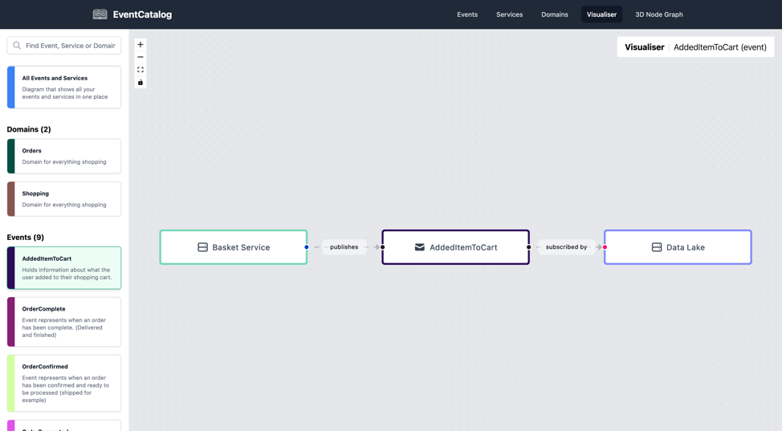
Event Catalog
https://github.com/boyney123/eventcatalog

Slide 132
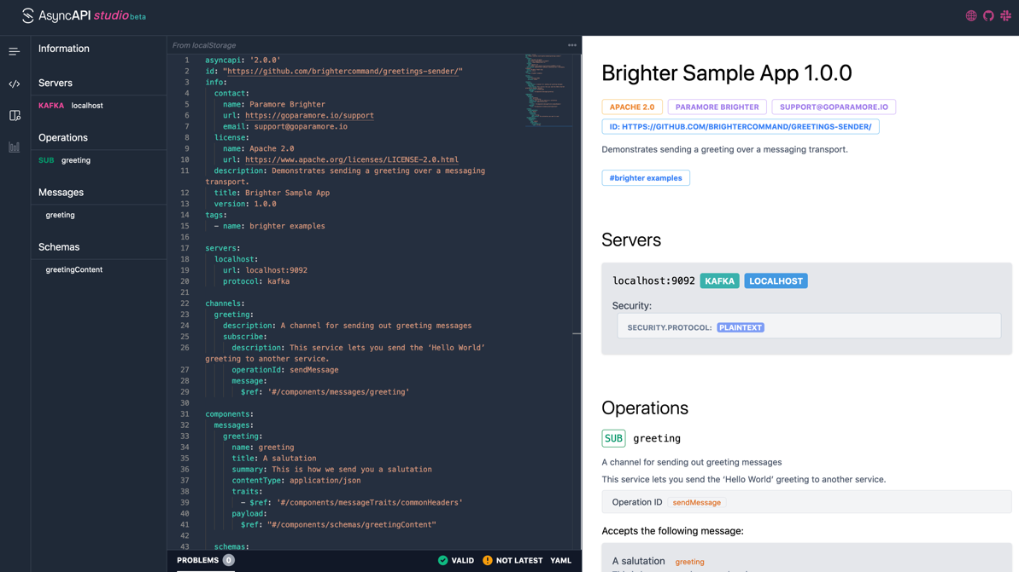
AsyncAPI Studio

Slide 133
Observability

Slide 134
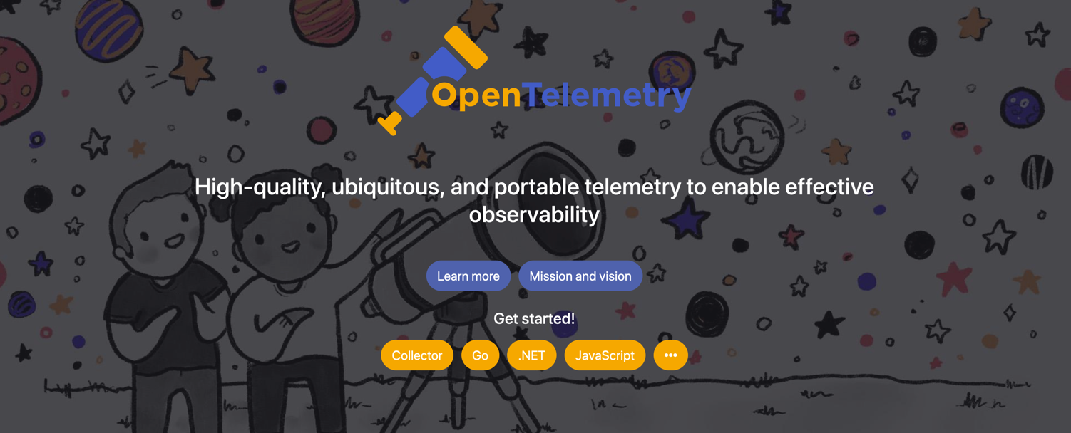

Slide 135
OpenTelemetry Tracing
Endpoint
Restaurant Availability
Downstream
Restaurant Management
We serialize the span context into the headers of the message when we send it
We begin a span when initiate a flow.
We begin a child span in the receiver

Slide 136



Slide 137

Further Reading

Slide 138
Q&A

